Slide 1
Introduction
Chapter 1

Slide 2

Dominating technologies in the past three centuries
  The 18th century: the time of the great mechanical systems accompanying the Industrial Revolution.
  The 19th century: the age of the steam engine.
  The 20th century: the key technology has been information gathering, processing, and distribution. E.g., telephone, radio, TV, computer, and satellites.

Slide 3

The Trends
  The differences between collecting, transporting, storing, and processing information are quickly disappearing.
  The merging of computers and communications has had a profound influence on the way computer systems are organized.
  The term of “computer networks” means an interconnected collection of autonomous computers. Two computers are said to be interconnected if they are able to exchange information.

Slide 4
Business Applications of Networks
Resource sharing: A network is needed because of the desire to make all programs, data, and equipment available to anyone on the network without regard to the physical location of the resource and the user.
High reliability: A network may have alternative sources of supply (e.g., replicated files, multiple CPUs, etc.). In case of one resource failure, the others could be used and the system continues to operate at reduced performance. This is a very important property for military, banking, air traffic control, and many other applications.
Saving money: A network may consist of many powerful small computers, one per user, with data kept on one or more shared file server machines, which offers a much better price/performance ratio than mainframes.In this model, the users are called clients, and the whole arrangement is called the client-server model.

Slide 5
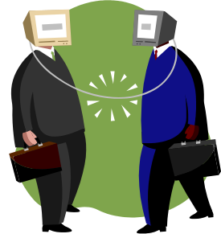
Powerful communication medium: Networks make cooperation among far-flung groups of people easy where it previously had been impossible. In the long run, the use of networks to enhance human-to-human communication may prove more important than technical goals such as improved reliability. E.g., Email, real-time collaborative editors/word-processors, and video conferencing.
E-business (B2B), or e-commerce (B2C)

Slide 6

Home Network Applications
Access to remote information
Starting in the 1990s, computer networks began to start delivering services to private individuals at home.
World Wild Web Surfing.
Online and personalized electronic newspapers, journals.
Digital library.
All these applications involve interactions between a person and a remote database.

Slide 7

Person-to-person communication
The 21st Century's answer to the 19th Century's telephone.
Electronic mails for everyone, which may contain digitized voice, pictures, moving TV and video images.
Instant messaging, or chat room.
Worldwide newsgroups for the population at large, and cover every conceivable topics.
Internet phone, video phone, Internet radio.
It is sometime said that transportation and communication are having a race, and whichever one wins will make the other obsolete.

Slide 8

Interactive entertainment
Video on demand (the killer application): the user can select any movie or TV program ever made, in any country, and have it displayed on his screen instantly.
Multi-person real-time games (maybe the alternative killer application): hide-and-seek, flight simulators, etc. If done with goggles and 3-dimensional real-time, photographic-quality moving images, we have a kind of worldwide shared virtual reality.

Slide 9
Network Hardware
Networks classification
Two important dimensions for classifying networks:
  Transmission technology, and
  Scale.
Two types of transmission technology
  Broadcast links
  Point-to-point links

Slide 10

Broadcast networks
Broadcast networks have a single communication channel shared by all the machines on the network. They work as follows:
  Packets sent by any machine are received by all the others.
  An address field within the packet specifies for whom it is intended.
  Upon receiving a packet, a machine checks the address field. If it is intended for itself, it processes the packet; otherwise, it is just ignored.

Slide 11
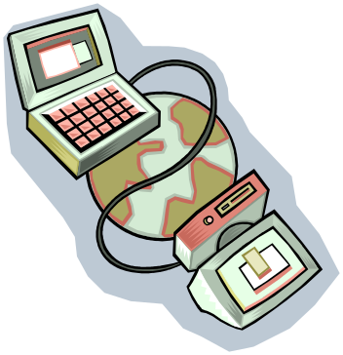
Point-to-point networks
Point-to-point networks consist of many connections between individual pairs of machines.
Multiple routes and intermediate machines may exist between a pair of machines, so routing algorithms play an important role here.
A general rule (with many exceptions): smaller and localized networks tend to use broadcasting, whereas larger networks usually are point-to-point.

Slide 12
Classification of interconnected processors by scale
Interprocessor
distance
Processors
Located in same
Example
1m | Square Meter
10m | Room
100m | Building
1km | Campus
10km | City
100km | Country
1000km | Continent
10,000km | Planet
Personal area network
Local area network
Metropolitan area network
Wide area network
The Internet

Slide 13
Local Area Networks
Distinguishable characteristics for LANs:
  Size: usually a diameter of not more than a few kilometres, with bounded and known worst-case transmission time, making special design and simple management possible.
  Transmission technology: usually a shared cable running at speeds of 10 to 100 Mbps (and even higher, up to 10Gbps), with delay of tens of microseconds and few errors.

Slide 14

Wide Area Networks
A WAN spans a large area, often a country or continent. A WAN consists of two parts:
  Application part: Machines for running user programs are called hosts.
  Communication part: The hosts are connected by the communication subnet, or just subnet, whose job is to carry messages from host to host.
The subnet consists of two components:
  Transmission lines (circuits, channels, or trunks) move bits between machines.
  Switching elements (routers) are specialized computers used to connect two or more transmission lines.

Slide 15
Main characters of WANs
A WAM contains numerous cables or telephone lines, each one connecting a pair of routers.
For those without direct connection, communication takes place indirectly via other routers.
When a message (a packet) is sent from one router to another, it is received at each intermediate router in its entirety, stored there until the required output line is free, and then forwarded. A subnet using this principle is called point-to-point, store-and-forward, or packet-switched subnet.
WANs may also use broadcast channels, such as satellites or ground radio systems.

Slide 16
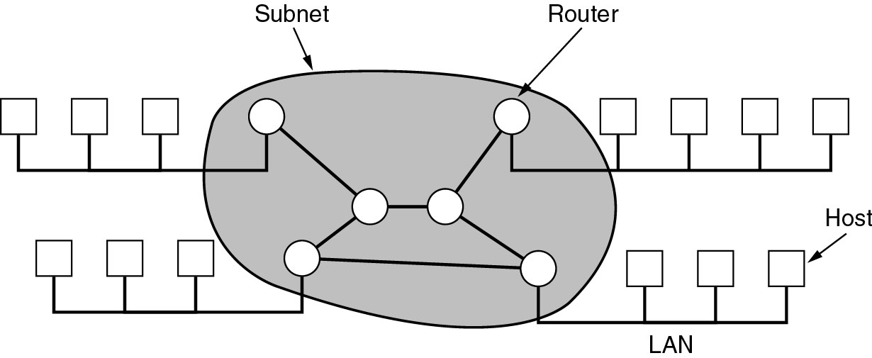
Store and forward

Slide 17
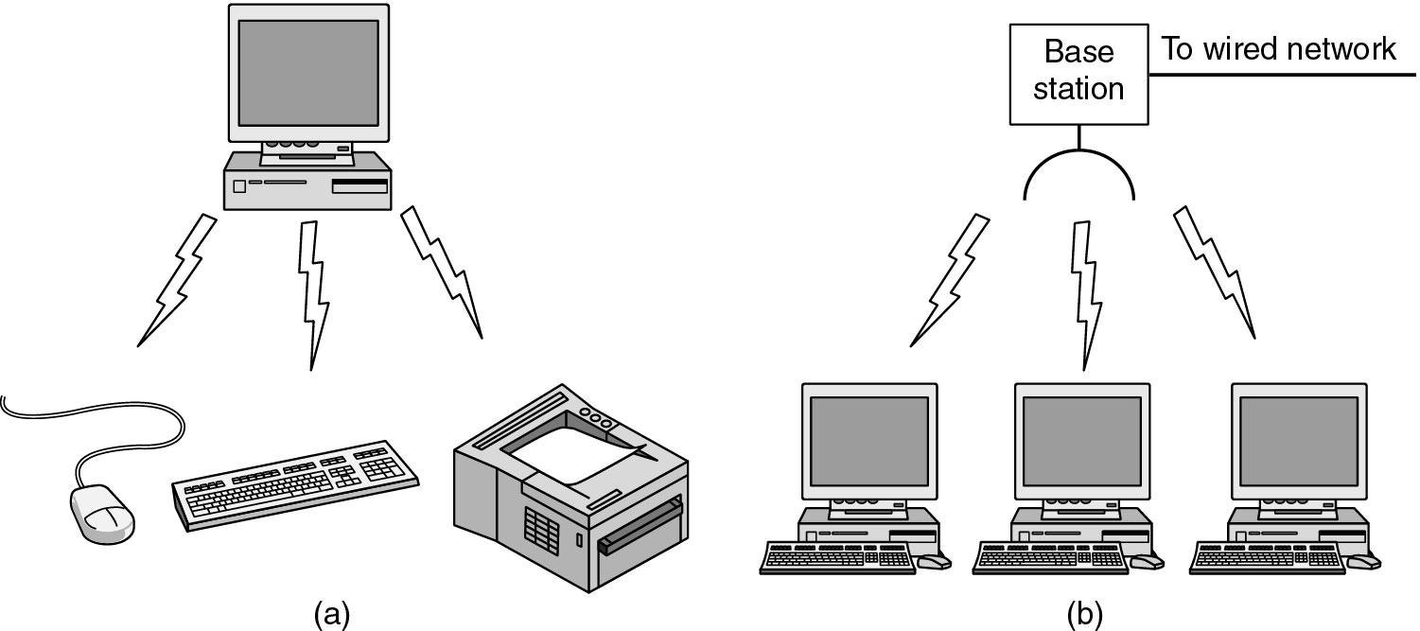
Wireless Networks
Bluetooth configuration
Wireless LAN

Slide 18

Internetworks
A collection of interconnected networks is called an internetwork or just internet.
The Internet refers to a specific worldwide internet that is widely used to connect universities, government offices, companies, and private individuals.
Both the general internet and the specific Internet will be extensively covered by this course.

Slide 19
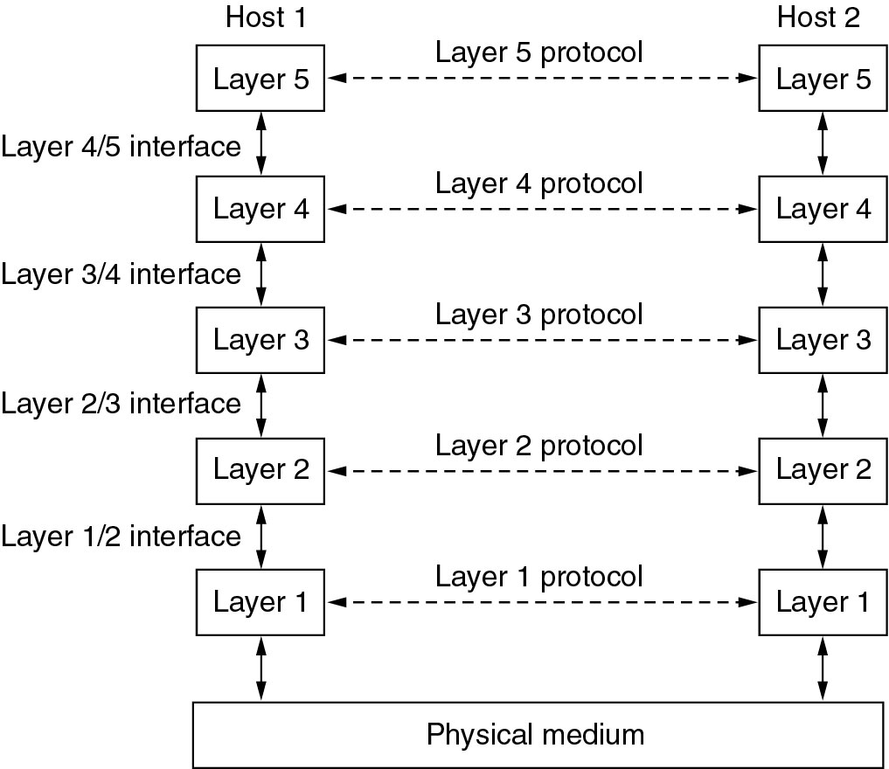
Network Software
Protocol Hierarchies
To reduce their design complexity, most networks are organized as a series of layers or levels.
Each layer offers certain services to the higher layers, shielding those layers from the details of how the offered services are actually implemented.
Layer on one machine carries on a conversation with layer on another machine. The rules and conventions used in this conversation are collectively known as the layer protocol.

Slide 20
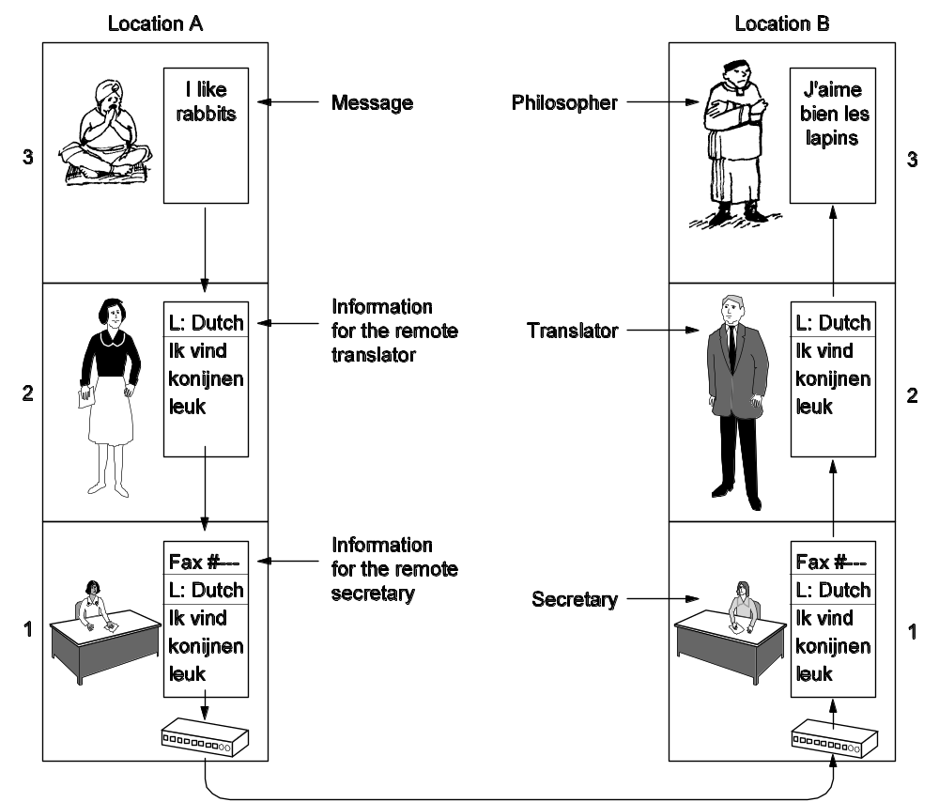
The philosopher-translator-secretary architecture

Slide 21
The philosopher-translator-secretary architecture
Two philosophers (peer processes in layer 3), one speaking English and the other speaking French, want to communicate.
Each one has to use a translator (peer processes at layer 2).
Each translator contacts a secretary (peer processes at layer 1) for message transmission.
For the philosopher 1 to convey his message to his peer, he passes his message in English to his translator, who may translate it into Dutch, or other language, depending on the layer 2 protocol.
The translator then gives the message to his secretary to transmit, by fax, telephone, email, or some other means, depending on layer 1 protocol.
When the message arrives, the peer secretary hands the message to the peer translator, who translates it into French and passed across the 2/3 interface to philosopher 2.

Slide 22

Connection-Oriented and Connectionless Services
Connection-oriented service is modeled after the telephone system. The essence of a connection is that it acts like a tube: the sender pushes objects in at one end, and the receiver takes them out in the same order at the other end. Connection-oriented services are suitable for communicating for a long time between two parties.
Connectionless service is modeled after the postal system. Each message carries the full address and is routed independently. The order is not guaranteed. Connectionless services are suitable for sending short messages.

Slide 23
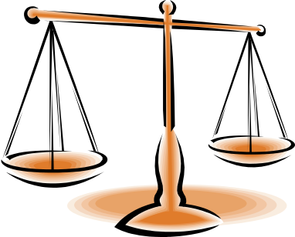
Quality of service
Reliable services guarantee they never lose data. This can be implemented by acknowledgements. The overhead introduced are often worth it, but sometimes undesirable (unreliable services).
File Transfer
Digitized Voice
Registered Mail
Electronic Junk Mail
Reliable Connection-Oriented
Unreliable Connection-Oriented
Reliable Connectionless
Unreliable Connectionless

Slide 24
Reference Models
The OSI Reference Model
The TCP/IP Reference Model
A Comparison of OSI and TCP/IP
The OSI model was proposed by the International Standards Organization. It is also called ISO OSI (Open System Interconnection) Reference Model.

Slide 25
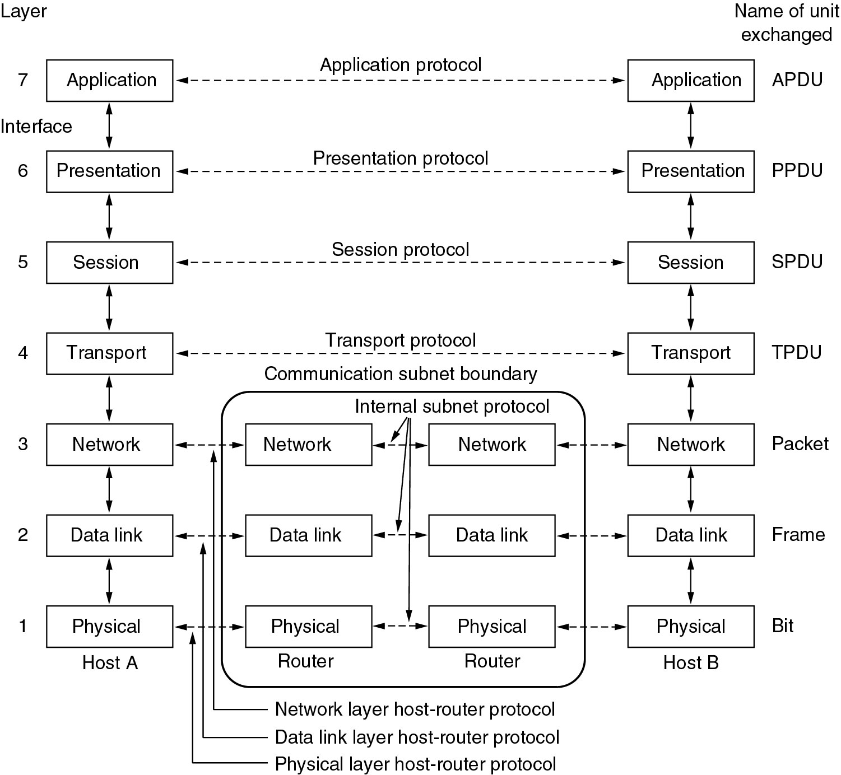
The OSI Reference Model

Slide 26
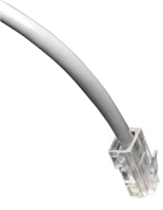
The physical layer
The physical layer is concerned with transmitting raw bits over a communication channel.
Typical questions (main design issues):
  How many volts should be used to represent a 1 and how many for a 0.
  How many microseconds a bit lasts.
  Whether transmission may proceed simultaneously in both directions.
  How the initial connection is established and how it is torn down when both sides are finished.
  How many pins the network connector has and what each pin is used for.
These issues belong to the domain of the electrical engineer.

Slide 27

The data link layer
It takes a raw transmission facility from the physical layer and transforms it into a line that appears free of undetected transmission errors to the network layer.
Main design issues:
  Break the input data up into data frames and transmit the frames sequentially.
  Process the acknowledgement frames sent back by the receiver.
  Retransmit lost or damaged frames, and solve the problem of possible duplicate frames.
  Offer several different service classes to the network layer, each of a different quality and price.
  Use some traffic regulation mechanism to let the transmitter know how much buffer space the receiver has at the moment. This flow regulation is frequently integrated with error handling.
  A Medium Access Control (MAC) sublayer is introduced to deal with the access control over the shared channel in broadcast networks.

Slide 28

The network layer
The main task of this layer is to control the operation of the subnet.
  Routing from source to destination: static, dynamic (per session or per packet).
  Congestion control.
  Allowing heterogeneous networks to be interconnected (internetworking): different addressing, length of packet, and protocols.
  Accounting: count the number of packets or character per customer.
In broadcast networks, the routing problem is simple, so the network layer is often thin or even nonexistent.

Slide 29

The transport layer
The basic function of this layer is to
  accept data from the session layer,
  split it up into smaller units if need be,
  pass these to the network layer, and
  ensure that the pieces all arrive correctly at the other side.
Type of services
  An error-free point-to-point channel that delivers messages in the order in which they were sent.
  Isolated messages with no guarantee about the order of delivery.
  Broadcasting of messages to multiple destinations.
The type of service is determined when the connection is established.
The transport layer is a true source-to-destination or end-to-end layer. Flow control between hosts is also needed but different from between routers (similar principles will apply to both).

Slide 30

The session and presentation layers
The session layer provides enhanced services useful in some applications, e.g., remote login, remote file transfer.
The presentation layer is concerned with the syntax and semantics of the information transmitted. Typical services:
  Encode data in a standard agreed upon way to facilitate information exchange among heterogeneous systems using different codes for strings (e.g., ASCII and Unicode), integers (e.g., one's complement and two's complement), and so on.
  Data compression for reducing the number of bits to be transmitted.
  Cryptography for privacy and authentication.

Slide 31

The application layer
This layer contains a variety of commonly needed protocols.
Typical services:
  Domain Name Service.
  Transfer files among different file systems.
  Electronic mails among different systems.
  Telnet.
  World Wide Web.

Slide 32
The TCP/IP reference model
The TCP/IP model was used in the grandparent of all wide area computer networks, the ARPANET, and its successor, the worldwide Internet.
The internet layer: the official packet format and protocol at this layer is called IP (Internet Protocol). Its job is to inject IP packets into any network and have them travel independently to the destination (potentially on a different network).
The TCP/IP internet layer is similar in functionality to the OSI network layer.
The transport layer: It is the same in functionality as the OSI transport layer. Two official end-to-end protocols:
TCP (Transmission Control Protocol): a reliable connection-oriented protocol.
UDP (User Datagram Protocol): an unreliable connectionless protocol.

Slide 33
The TCP/IP reference model (2)
The application layer: The TCP/IP model does not have session or presentation layers, which are of little use to most applications. The top application layer contains all the higher-level protocols. Many other protocols, such as HTTP used on the World Wide Web, have been added over the years.
The host-to-network layer: The layer below the internet layer is a great void. The TCP/IP model just points out that the host has to connect to the network using some protocol so it can send IP packets over it. This protocol is not defined and varies from host and network to network.

Slide 34
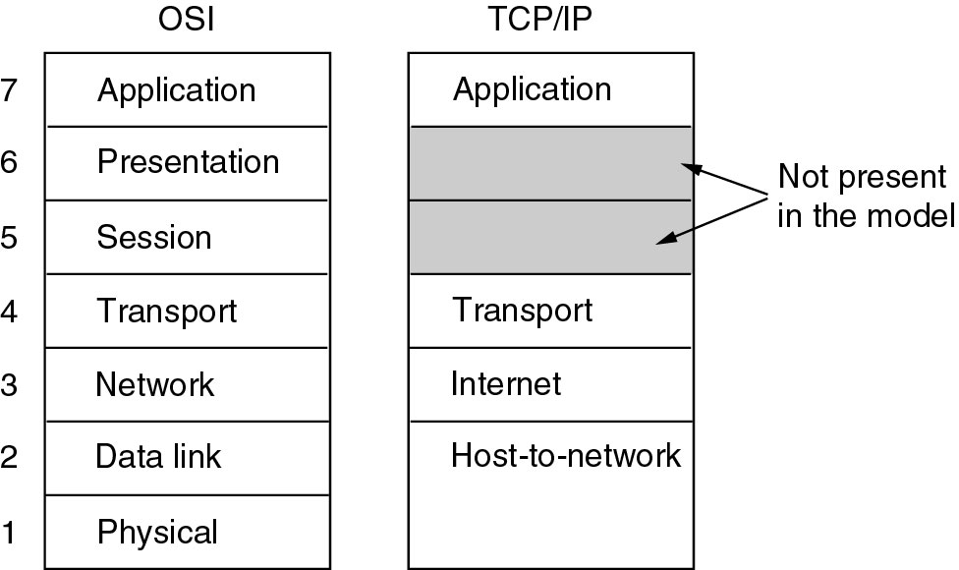
The TCP/IP reference model (3)
X

Slide 35
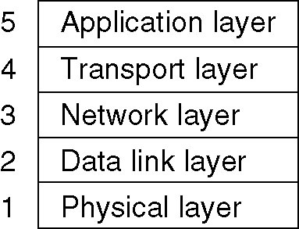
Hybrid Model
The OSI model minus the session and presentation layers is exceptionally useful for discussing computer networks, but the OSI protocols have not become popular.
The TCP/IP model is practically nonexistent, but the protocols are widely used.
The following hybrid reference model to be used in this course.

